Slide 1

BLG561E Deep Learning Term Project Presentation
Handwrite Text Recognition
704241020 - Alper Berkin YAZICI
704241023 - Furkan GÜNEY
07.01.2025

Slide 2

Problem Definition
Problem
Handwrite Text Recognition (HTR) involves converting handwritten text into digital form, essential for digitizing documents and automating data entry. The task is challenging due to variations in handwriting styles, instruments, and environmental conditions, making letters and words difficult to standardize and recognize.
Challenges
HTR faces significant challenges from the diversity of handwriting styles, ranging from neat to highly ambiguous scripts. Noise in scanned images, such as blurring or smudging, adds to the complexity. Additionally, obtaining diverse, labeled datasets remains a key limitation for training effective models.
Goals
The primary goal of Handwrite Text Recognition is to develop a model that can accurately and efficiently convert handwritten text into digital text. This involves preprocessing the data to enhance readability, designing robust machine learning models to handle variability, and evaluating the model's performance across diverse datasets..

Slide 3





About Dataset
From Kaggle : https://www.kaggle.com/datasets/vaibhao/handwritten-characters/data
The dataset is derived from the EMNIST data, encompassing alphabets and digits. It has been processed to create 32x32 pixel black-and-white images using image processing techniques.
Special characters such as @, #, $, and & were added, and categories were merged to reduce misclassification.
The dataset consists of 39 categories: 26 for alphabets (combining uppercase and lowercase letters into single classes), 9 for digits (with digit 0 combined with the letter O), and 4 for special characters.
This structured dataset is designed to support efficient training and evaluation of handwriting recognition models.

Slide 4
Our Contribution to Data
While creating the dataset, we examined the existing dataset and characters. Then, we created a draft and collected alphabets consisting of 26 letters written by 32 different people, including English and capital letters "ABCDEFGHIJKLMNOPQRSTUVWXYZ". We divided the letters written by each person into folders and labeled them. We resized this dataset we created to fit the dimensions of the existing dataset and applied preprocessing operations. After completing these operations, we combined the dataset we created with the existing dataset and used this combined dataset to train our model. With the training of the model, we collected 32 different handwritten names to test its performance and tested the performance of the model by trying to recognize these names.

Slide 5
Possible Solution Methods
CNN-Based Approach
Convolutional Neural Networks (CNNs) are widely used for image recognition tasks. For handwriting recognition, CNNs can process character-level data effectively by learning spatial hierarchies in the images. The typical pipeline involves preprocessing the images, extracting features using convolutional layers, and applying fully connected layers for classification. However, CNNs are less effective for handling sequential dependencies, making them more suited for isolated character recognition rather than full text lines.
CRNN-Based Approach
Convolutional Recurrent Neural Networks (CRNNs) combine the strengths of CNNs and RNNs, making them ideal for sequential tasks like handwriting recognition. CNN layers extract spatial features, while RNN layers capture sequential dependencies in the text. This approach is particularly effective for recognizing full words or sentences. A Connectionist Temporal Classification (CTC) layer is often added to handle varying input lengths and alignments.
Vision Transformer (ViT) Approach
Vision Transformers (ViTs) process images as sequences of patches and capture global relationships using self-attention. They are particularly effective for complex handwriting recognition tasks due to their ability to model long-range dependencies and global patterns, but they require more computational resources compared to CNNs or CRNNs.

Slide 6
Our Approach
CNN-Based Approach
Data Preprocessing
The dataset was preprocessed to ensure consistency and compatibility with the CNN model. Each image was resized to 32x32 pixels to standardize input dimensions. Pixel values were normalized to the range [0, 1], improving the model's training stability and convergence.
Model Architecture
The CNN architecture consists of multiple convolutional layers that extract spatial features from the input images. Leaky ReLU activation functions were applied after each convolution to introduce non-linearity, followed by max-pooling layers to reduce spatial dimensions and computational complexity. Fully connected layers were added at the end of the network for classification, with a softmax activation function in the output layer to predict class probabilities.
Training Process
The model was trained using the categorical cross-entropy loss function. The RMSProp optimizer was employed for efficient gradient updates, and training was conducted in mini-batches, ensuring better convergence.
Validation and Testing
Validation was performed during training to monitor the model’s performance on unseen data. This process helped in fine-tuning hyperparameters to enhance the model's generalization. Once trained, the model was tested on a separate test set to evaluate its accuracy and robustness in recognizing handwritten characters.

Slide 7

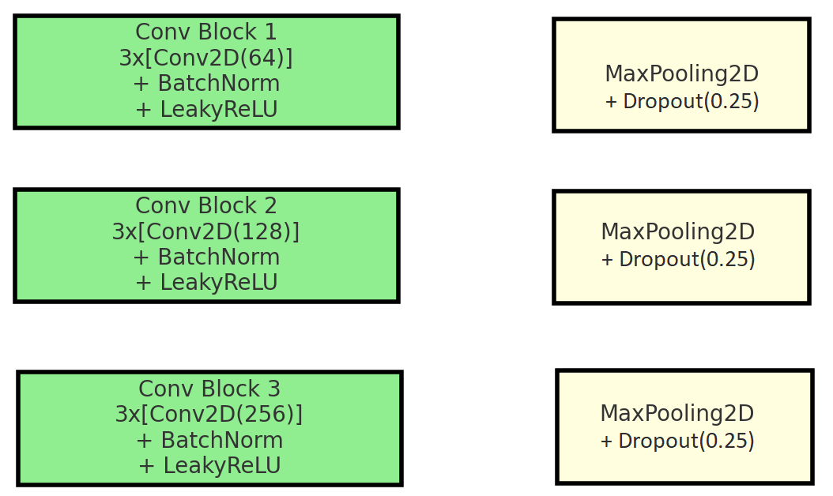
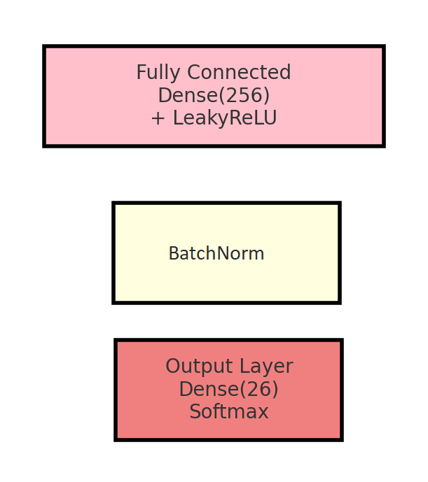
Model Structure and Training
GÖRSEL ALAN
GÖRSEL ALAN
Sunumu Hazırlayan

Slide 8
Model Structure and Training

Slide 9
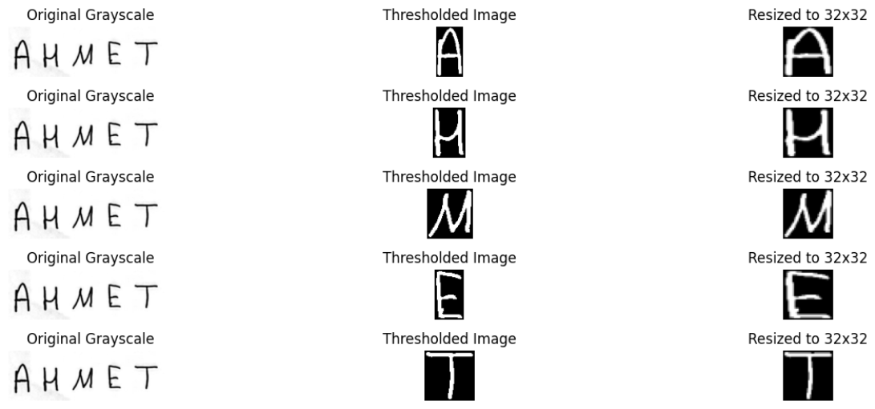
Results
TRUE WORD: AHMET

Slide 10
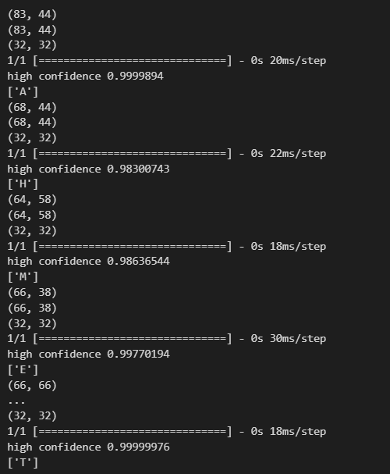
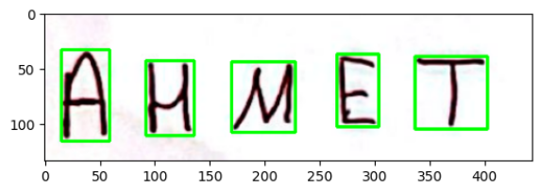
Results
PREDICTED WORD: AHMET

Slide 11
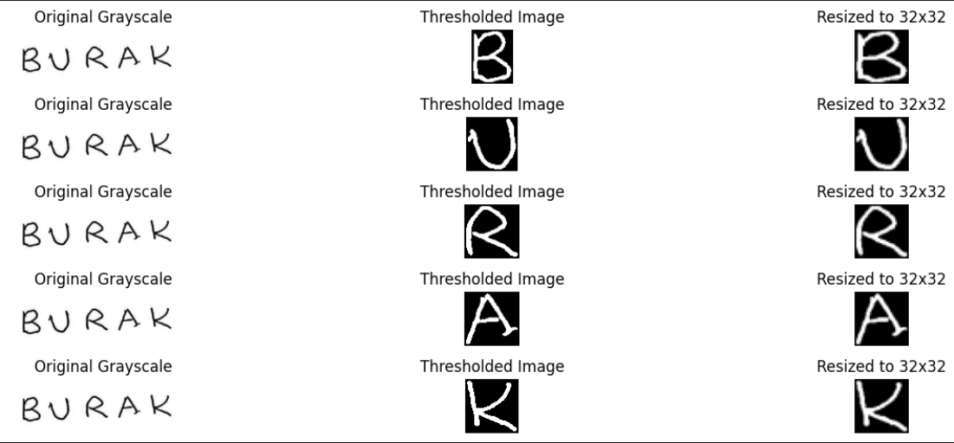
Results
TRUE WORD: BURAK

Slide 12
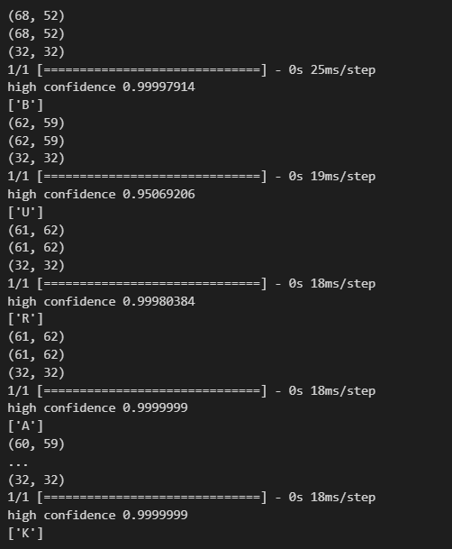
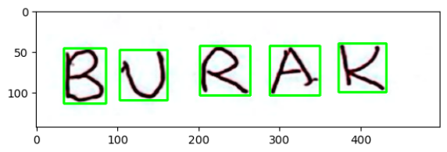
Results
PREDICTED WORD: BURAK

Slide 13
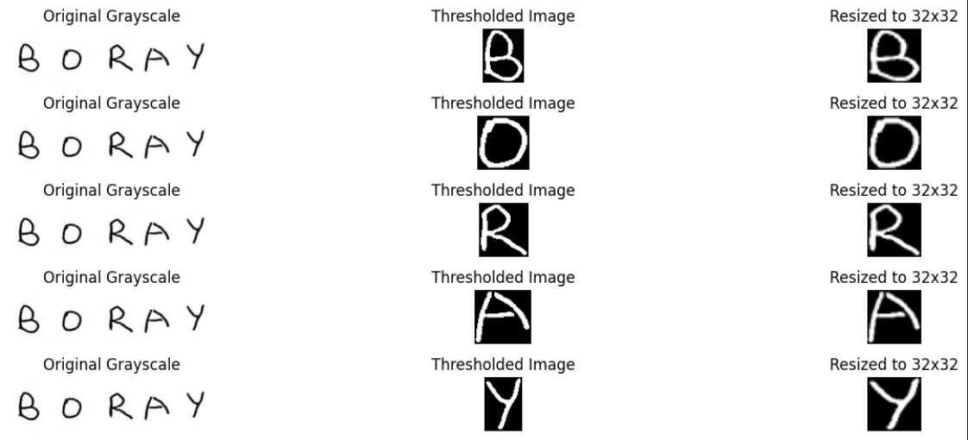
Results
TRUE WORD: BORAY

Slide 14
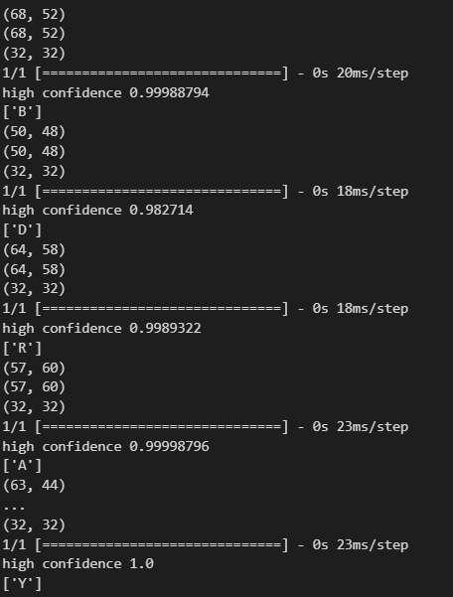
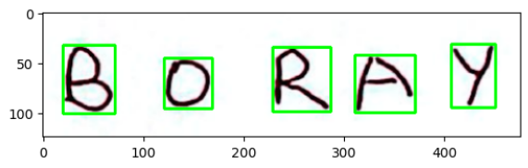
Results
PREDICTED: BURAK

Slide 15
Conclusion
In conclusion, throughout our term project, we aimed to train a handwriting recognition model by applying the knowledge we have acquired so far and leveraging external resources. Thank you for your attention.

Slide 16

BLG561E Deep Learning Term Project Presentation
704241020- Alper Berkin YAZICI
704241023-Furkan GÜNEY
07.01.2025

